Slide 1

Hate-Free Speech
Kelvin Ortiz

Slide 2



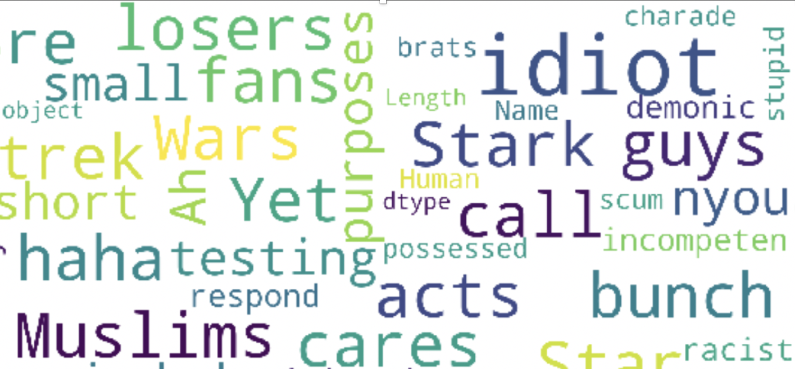
Let’s fight Hate

Slide 3

Dataset
Comment | Toxicity
‘Islam, where women are treated like property and beat and stoned.’ | 1.0
'I hope all gays end up with HIV and STD viruses.' | 1.0
‘Go back to your safe room’ | 0.4
'Love it!' | 0.0
App comments (1.8million)
Target: Level of humanity by 10 other people
Toxic: | 10.7 %
Non-Toxic: | 89.3 %

Slide 4
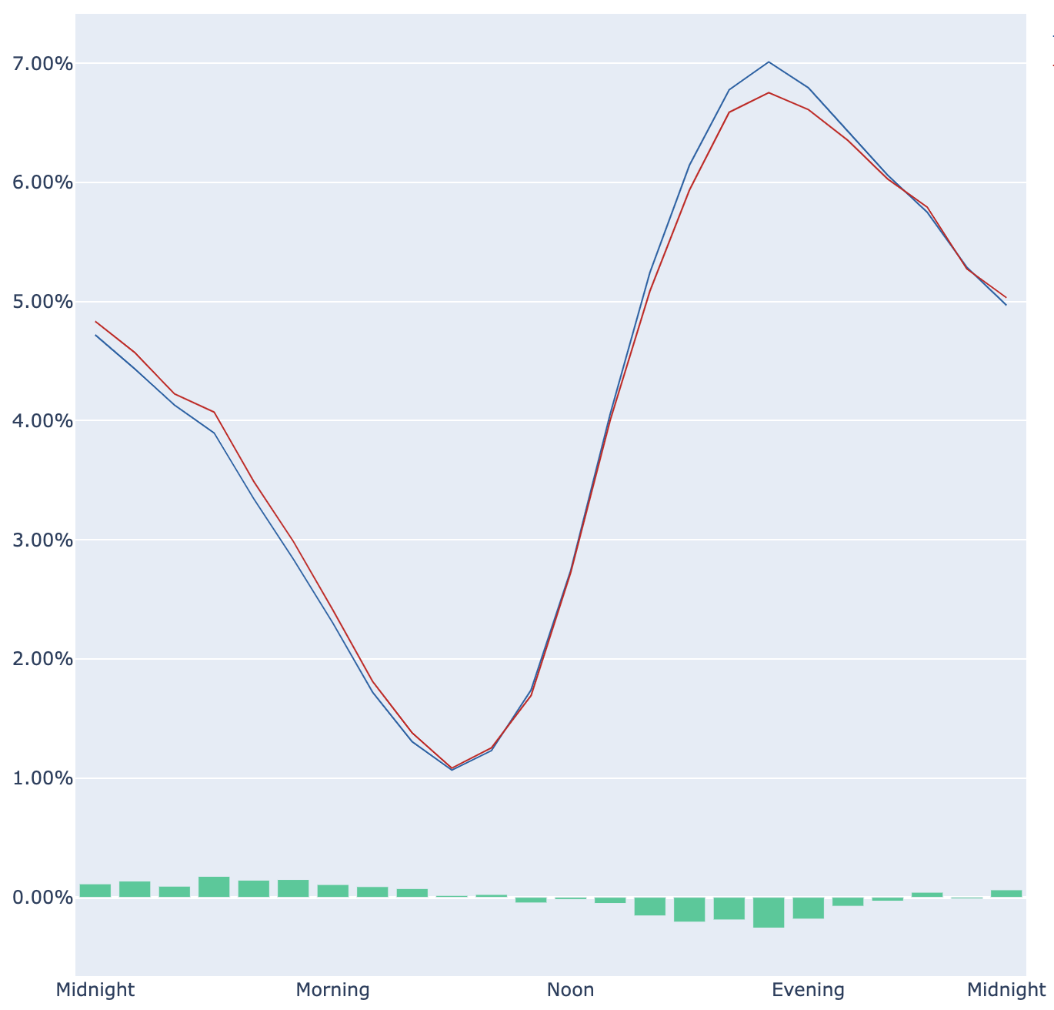

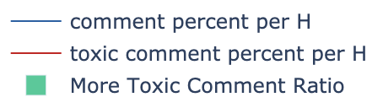
Toxicity percentage per Day/Hour
People are the most Toxic from midnight to 9am
Increase of toxicity

Slide 5

Identities in Toxic comments
5

Slide 6
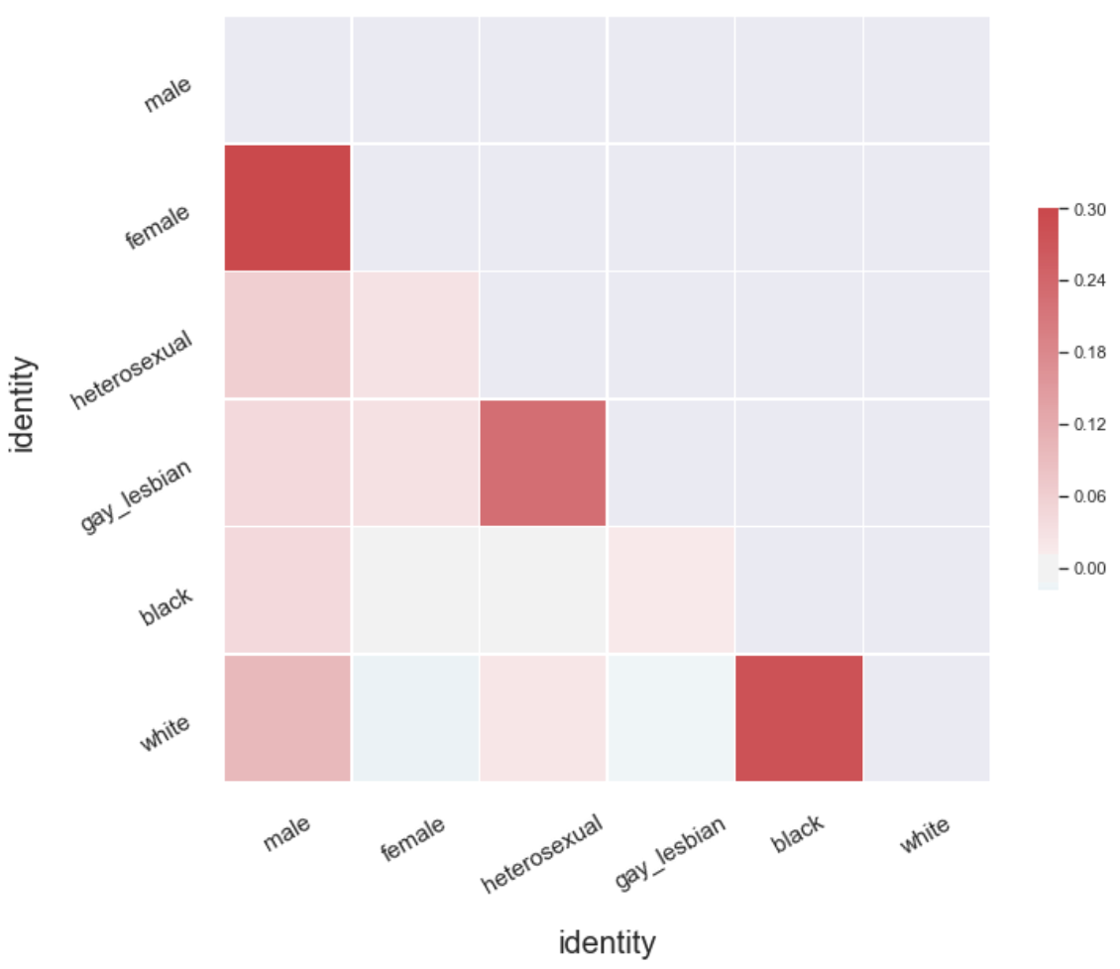
Correlation of Identities in Toxic comments
Female vs Male
Homosexual vs heterosexual
Black vs White

Slide 7
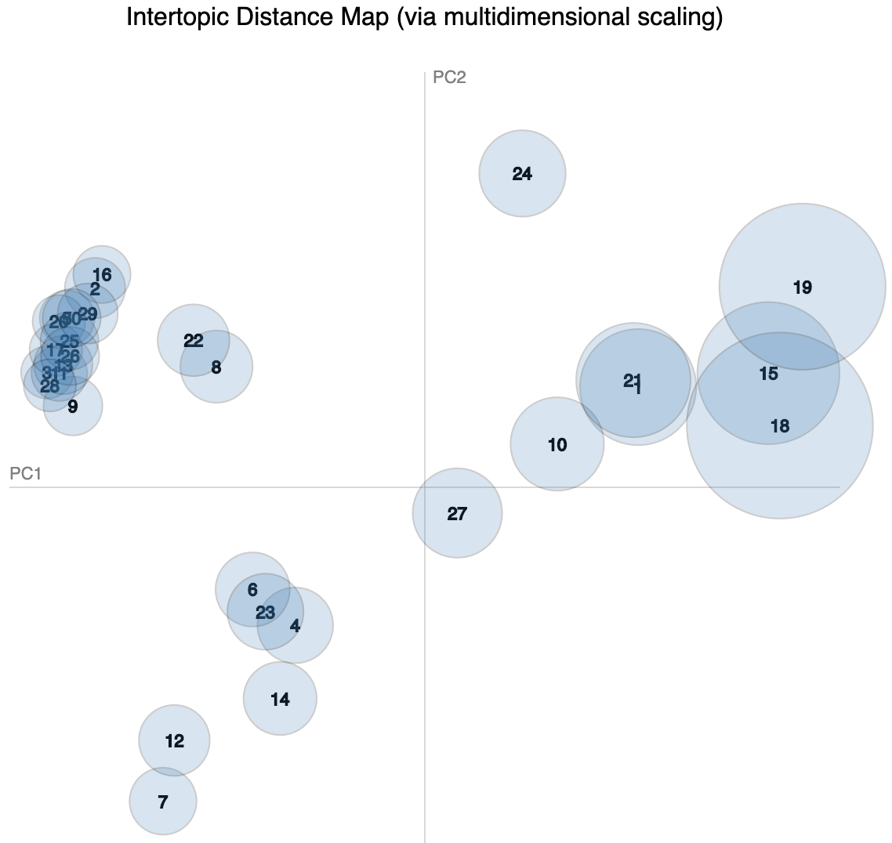

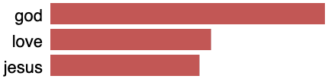
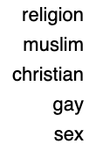
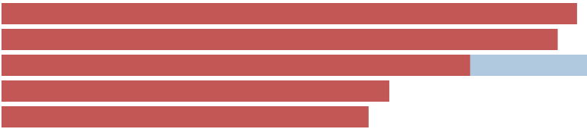
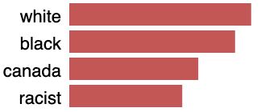
Topic Modeling
Right/thought
Money/Government
LDA, 30 Topics
Topics
Love/Religion
Women/Sexual Abuse
Slavery
Racism
Homophobia
Sexual Abuse
Religion/Sexual orientation
America/War/Slavery
Racism

Slide 8
Toxicity in Topic Modeling
Logistic Regression Coef
Weighted Label by Topic
Too white. They don't matter
Topic 40: Race
“Not to white people, because they did not experience any discrimination”
Topic: Politics
“transgender is a mental disorder”

Slide 9

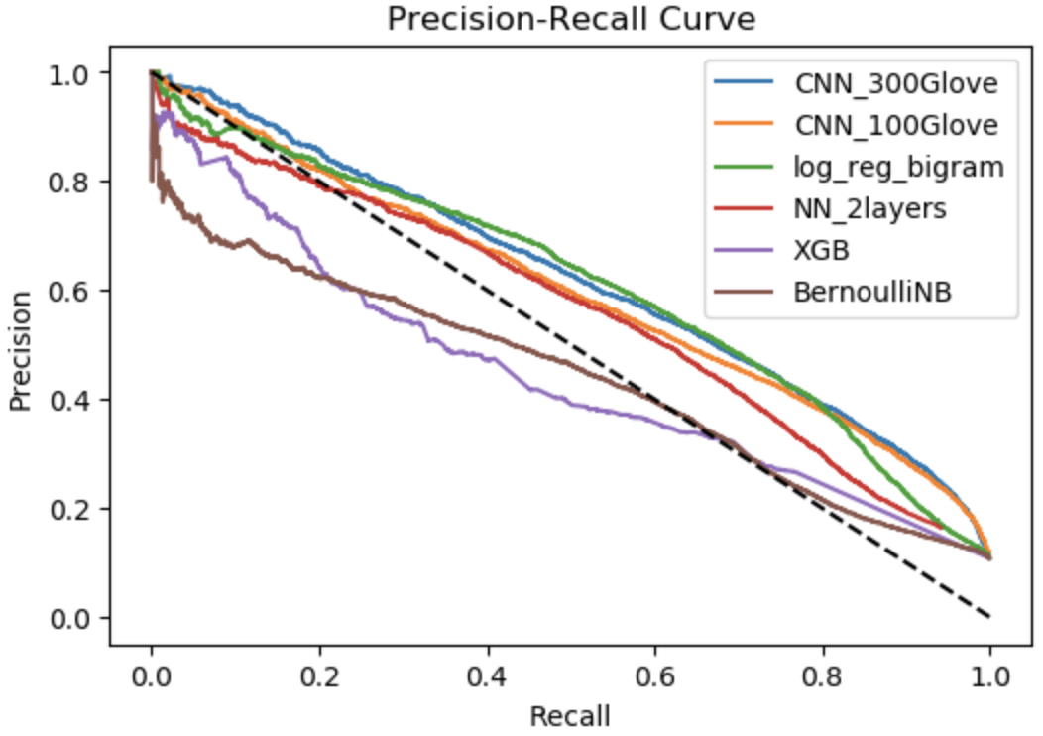
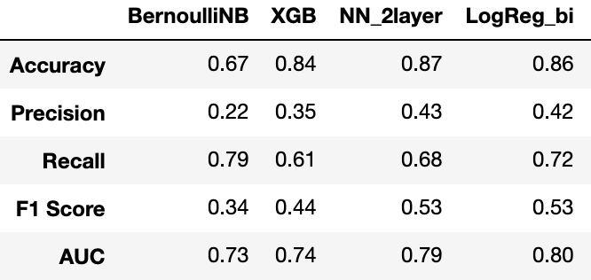
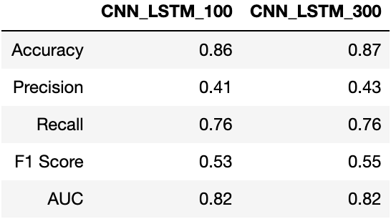

Classification Metrics (1)
X: Text
Padded Sequences
Glove Embeddings (100/300)
Dropout 30%
Convolution
Precision/Recall
Max Pooling (4)
Dropout 30%
LSTM

Slide 10
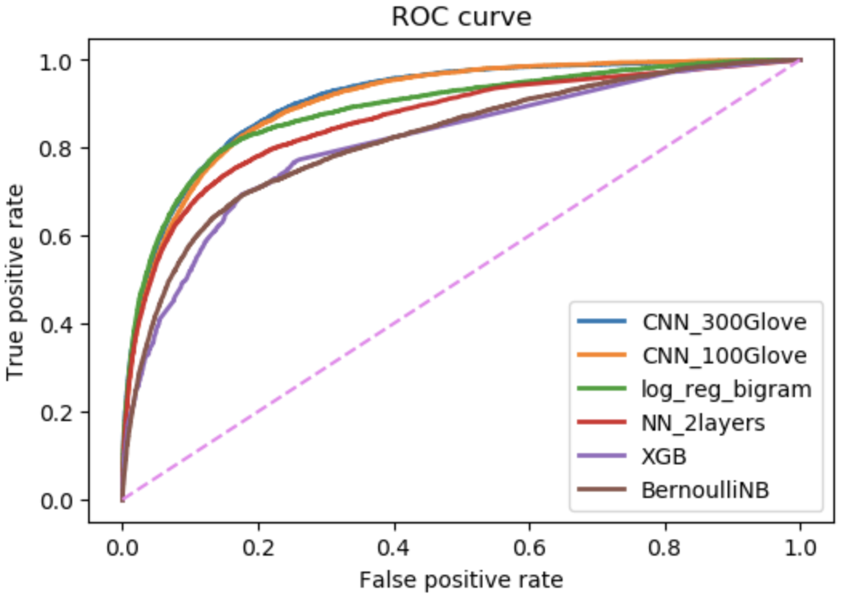
Classification Metrics (2)
X: Text
Padded Sequences
Glove Embeddings (100/300)
Dropout 30%
Convolution
AUC/ROC
Max Pooling (4)
Dropout 30%
LSTM

Slide 11


Thank you!
https://github.com/iopkelvin

Slide 12
Toxicity in Topic Modeling (1)
Logistic Regression Coef
Topic 40: Race
“Many illegal aliens are white Hispanics. Many white Hispanics are racist due mainly to their race. Got it?”
“Not to white people, of course because they did not experience any discrimination”
Too white. They don't matter

Slide 13
Toxicity in Topic Modeling (2)
Weighted Topic components
Topic: Idiot
“stupidest post of the day, congratulations”
Topic: Politics
“you are no conservative just plain ol white trash”
“transgender is a mental disorder”

